Slide 1

Autonomous Taxi Agent: A Reinforcement Learning Approach
GHOSH Prabal, ILLAHIBUCCUS SONA Ishfaaq, HAMMED Habeeb Olawale

Slide 2
Agenda
Introduction
Problem Statement
Experimental Setup
Overview of Algorithms
Results and Observations
Comparison Table
Key Takeaways
Conclusion

Slide 3
Introduction
Reinforcement Learning (RL): A machine learning paradigm where an agent learns by interacting with an environment.
Objective: Train an autonomous taxi agent to pick up and drop off passengers efficiently.
Algorithms Compared:
Q-Learning (Off-policy, model-free)
SARSA (On-policy, model-free)
Deep Q-Network (DQN) (Neural network-based Q-learning)
Value Iteration (Model-based, dynamic programming)

Slide 4
Problem Statement
Environment: OpenAI Gym Taxi-v3
The Taxi-v3 environment is a grid-based game where a taxi agent must:
Pick up a passenger from one of the predefined locations.
Navigate to the passenger’s destination while avoiding penalties.
State Space
The environment has 500 discrete states.
Each state represents a combination of:
The taxi’s location (5×5 grid = 25 positions).
The passenger’s location (one of 4 fixed locations or in the taxi).
The passenger’s destination (one of 4 locations).
The state is a single integer representing these factors.

Slide 5
Problem Statement
Action Space
There are 6 discrete actions:
Move South
Move North
Move East
Move West
Pickup Passenger
Drop off Passenger
Rewards
+20 for successfully dropping off a passenger.
-10 for trying to pick up/drop off incorrectly.
-1 for each movement (to encourage efficiency).

Slide 6
Experimental Setup
Common Parameters:
Number of episodes, step limits, learning rate, discount factor, exploration rate.
Performance Metrics:
Reward per episode.
Q-table or neural network evaluation.
Stability vs. speed of convergence.

Slide 7
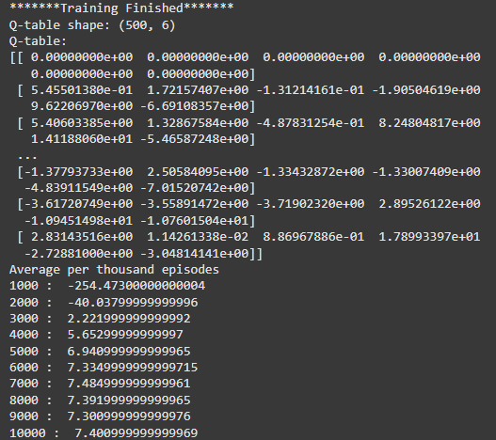
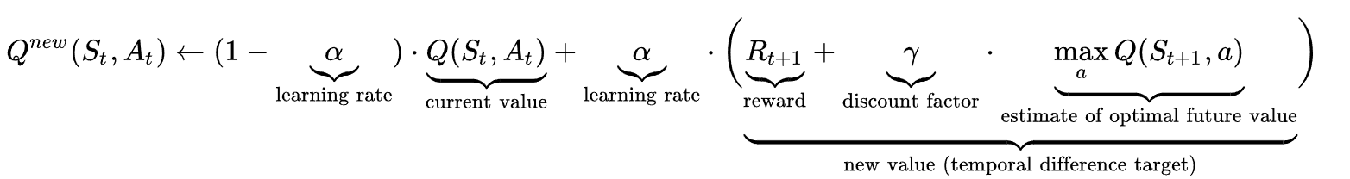
Algorithms Overview
Q-Learning
Off-policy: Updates Q-values based on max estimated future reward.
Greedy approach: Faster convergence but less stable.

Slide 8
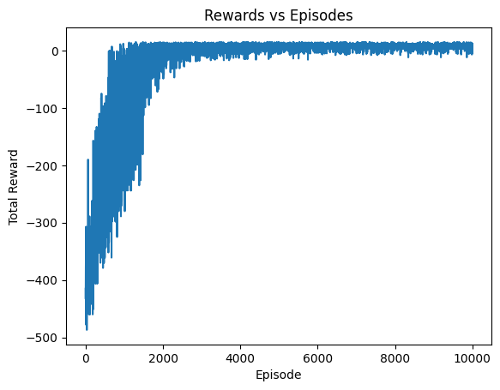
Q-Learning output

Slide 9
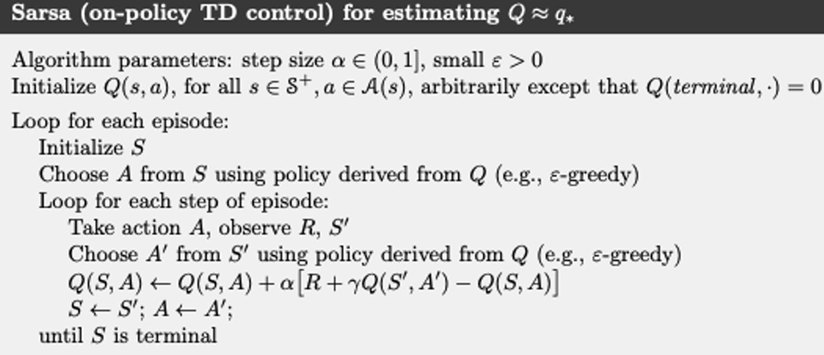
Algorithms Overview
SARSA
On-policy: Uses the actual action taken for updates.
More stable but converges slower than Q-Learning.

Slide 10
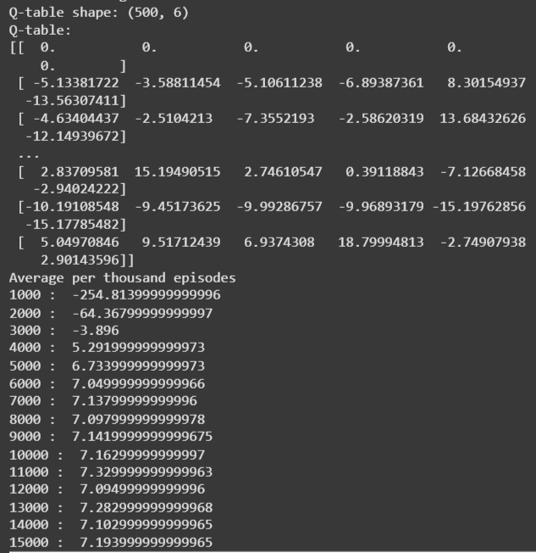
SARSA OUTPUT

Slide 11
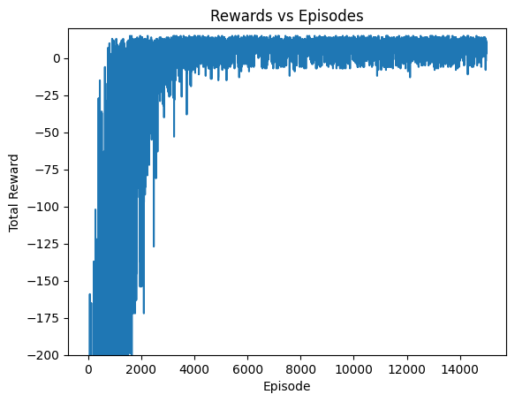
SARSA OUTPUT

Slide 12
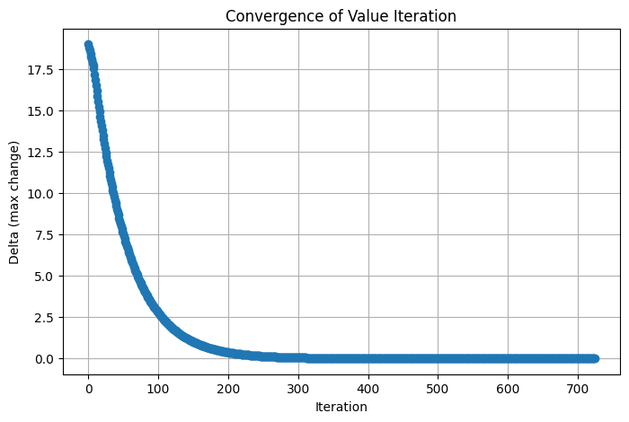
Algorithms Overview
Value Iteration converged in 725 iterations.
Value Iteration:
Model-based: Uses Dynamic Programming (DP).
Computes optimal policy iteratively using Bellman Optimality Equation.
Fast and stable but computationally expensive in large state spaces.

Slide 13
Value Iteration OUTPUT

Slide 14
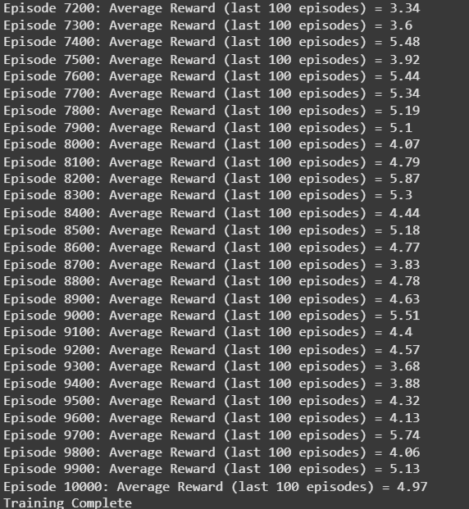
Algorithms Overview
DQN:
Neural network-based Q-learning.
Uses experience replay and target networks.
Effective in large state spaces but struggles in small environments.

Slide 15
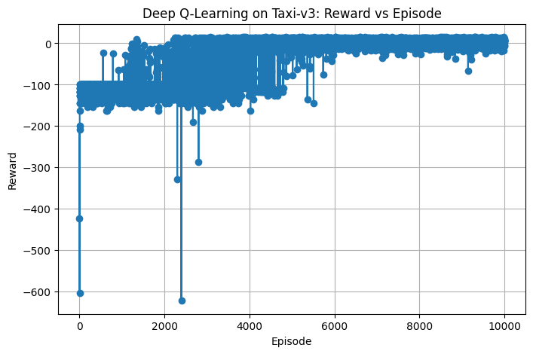
DQN OUTPUT

Slide 16
Results and Observations
Q-Learning
✅ Fast convergence (~7.5 avg. reward) ⚠️ Slight instability in early training.
SARSA
✅ More stable learning (~7.3-7.5 avg. reward) ⚠️ Slower convergence.
DQN
⚠️ Poor performance (~-1.02 avg. reward) ⚠️ Unstable learning, requires tuning.
Value Iteration
✅ Fastest convergence (~optimal policy achieved) ✅ Most stable, but high computation cost.

Slide 17
Results and Observations
Algorithm | Type | Convergence Speed | Stability | Final Performance
Q-Learning | Off-Policy | Fast | Moderate | ~7.5
SARSA | On-Policy | Slower | More Stable | ~7.3-7.5
DQN | Deep Learning | Slow | Least Stable | ~5.4
Value Iteration | DP-Based | Fastest | Most Stable | Optimal

Slide 18
Key Takeaways
Value Iteration is best for small environments (fast, stable, optimal policy).
Q-Learning is fast but slightly unstable (good for quick learning).
SARSA is slower but stable (avoids aggressive actions).
DQN is ineffective in small discrete environments (better suited for complex tasks).

Slide 19
Conclusion
Successfully trained an autonomous taxi agent using RL.
Compared and analyzed Q-Learning, SARSA, DQN, and Value Iteration.
Identified strengths, weaknesses, and best use cases for each algorithm

Slide 20
Thank you Questions?

